Slide 1

Chapter 6 I/O Systems, File & DISK Management

Slide 2
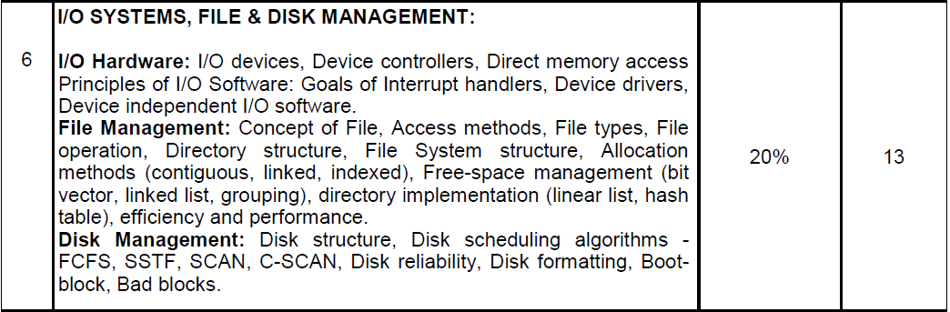
Syllabus

Slide 3
Input/Output Hardware

Slide 4
I/O DEVICE
I/O Device are of two types
Block Device
Character Device

Slide 5
Block Device
Block device stores information in fixed size blocks
A Block device is one with which the driver communicates by sending entire blocks of data.
Examples for Block Devices: hard disks, USB.

Slide 6
Character Device
A Character device is one with which the driver communicates by sending and receiving single characters (bytes, octets).
Character devices can be thought of as serial streams of sequential data
Examples for Character Devices: serial ports, parallel ports, sounds cards, Keyboard

Slide 7
Device Controller
Device controller is a collection of electronics that can operate a port, a bus, or a device. A serial-port controller is an example of a simple device controller.
Interaction with a device controller is managed through a device driver.

Slide 8
Device controller
It is a single chip in the computer that controls the signals on the wires of a serial port.
Any device connected to the computer is connected by a plug and socket, and the socket is connected to a device controller
Each device controller has a local buffer and a command register.
It communicates with the CPU by interrupts. A device's controller plays an important role in the operation of that device.
It functions as a bridge between the device and the operating system.

Slide 9
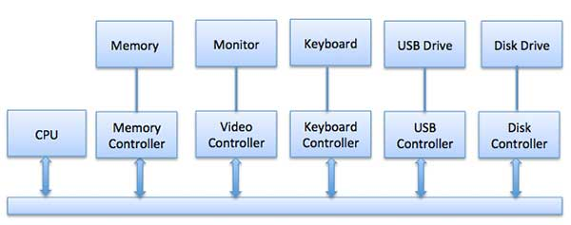

Slide 10
Examples of Device Controller
Network card
Disk controller
DVD-ROM controller
USB
Serial port
Sound card

Slide 11
Memory Mapped I/O
It is the communication method among CPU, Memory and I/O
This configuration uses same bus and same control signals but unique address space between memory and I/O.
Same address space is shared by memory and I/O devices. But some addresses represent memory cells, while others represents registers in I/O devices
In this mechanism, whenever the CPU generates the memory request. Even the control signals are matching but address space is not matching therefore only one node can perform the operation

Slide 12
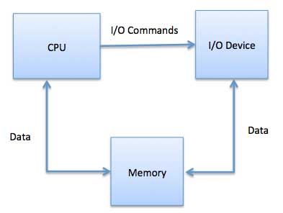

Slide 13
Advantages of memory mapped I/O:
It makes programming simpler
It does not have special commands to access I/O devices
Disadvantages of memory mapped I/O
Memory utilization is poor
It is suitable only when the processor consist the limited numbers of I/O ports

Slide 14
DMA (Direct Memory Access)
A special unit may be provided to allow transfer of block of data directly between external device and the main memory, without continuous intervention by the processor. This approach is called Direct Memory Access (DMA)
This means that once reading and writing has begun, the remainder of the data can be transferred to and from memory without processor (CPU) intervention

Slide 15
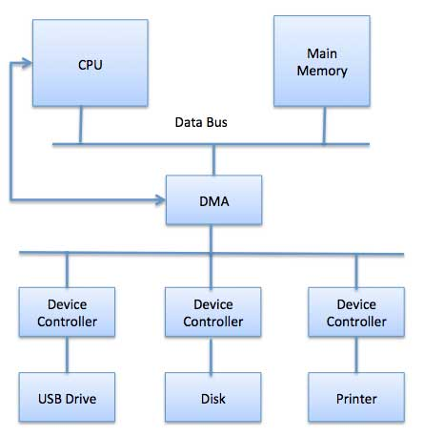

Slide 16
Direct Memory Access
DMA is particularly useful on devices like disks, where many bytes of information can be transferred in single I/O operations
When used in conjunction with an interrupt, CPU is notified only after the entire block of data has been transferred
Direct Memory Access is an I/O technique that allows a control unit to directly access main memory.
Without DMA, the processor is responsible for the physical movement of data between main memory and device.

Slide 17
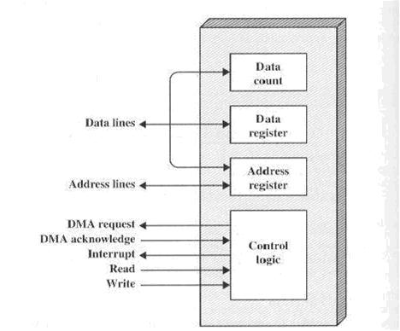
Block diagram of DMA

Slide 18
Working of DMA
During execution of first part of the user program, the CPU initializes the DMA with control signals, IO address, Memory starting address and the count value
Then the CPU is busy with execution of the part1(user program part1). Simultaneously the DMA initializes the operation to the corresponding IO device by sending the DMA request signal
After Preparing the data, the I/O device sends the DMA ACK signal to the DMA

Slide 19
Working of DMA
Whenever the DMA module receives the ACK signal from the IO, it enables the HOLD signal for the purpose of gain the control of the bus and it is waiting for the HOLD ACK signal.
When the processor receives the HOLD signal it enables the HOLD ACK (HLDA) signal.
Whenever DMA receives HLDA signal, it transfer the data from the IO device to memory until the count becomes zero
Until transfer the data, the CPU is in the blocked state. After completion of data transfer operation, the DMA reestablish the bus connection to the CPU

Slide 20
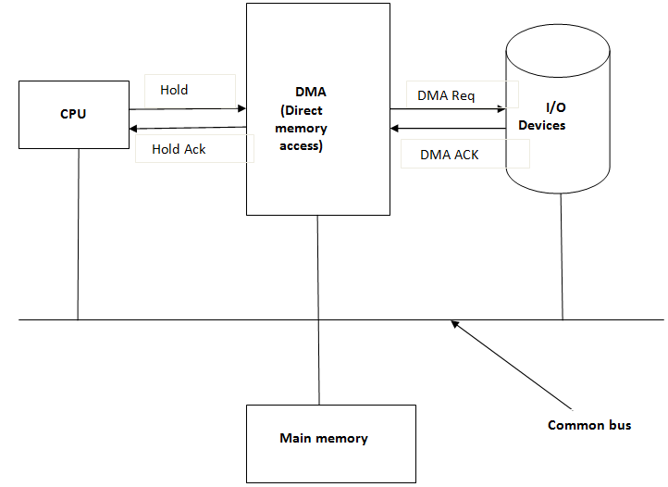
DMA working

Slide 21
DMA is operated under 3 modes
Burst mode
Cycle stealing mode
Blocked mode

Slide 22
DMA working modes
Burst Mode: In the burst mode of DMA, it transfer a bulk amount of data from the IO to M/Y, after receiving the HLDA signal
Cycle stealing mode: The DMA forcefully suspends the CPU operation and take the control of bus that means without receiving the hold acknowledgement(HLDA) signal, the DMA gains the control of bus. In this mode, DMA transfers the very important data to the memory and reestablish the connection to the CPU
Block Mode: DMA transfers the data in the form of blocks

Slide 23
Advantages of DMA
High transfer rates
Fewer CPU cycles for each transfer
Disadvantages of DMA
Expensive system
Synchronization mechanism must be provided in order to avoid accessing non-updated information from RAM

Slide 24
Polling vs Interrupts I/O
A computer must have a way of detecting the arrival of any type of input.
There are two ways that this can happen, known as polling and interrupts.
Polling I/O: The process of periodically checking status of the device to see if it is time for the next I/O operation, is called polling.
The I/O device simply puts the information in a Status register, and the processor must come and get the information.

Slide 25
Interrupts I/O:
An alternative scheme for dealing with I/O is the interrupt-driven method.
An interrupt is a signal to the microprocessor from a device that requires attention.
A device controller puts an interrupt signal on the bus when it needs CPU’s attention when CPU receives an interrupt, It saves its current state and invokes the appropriate interrupt handler using the interrupt vector (addresses of OS routines to handle various events).
When the interrupting device has been dealt with, the CPU continues with its original task as if it had never been interrupted.

Slide 26
Sharable vs. Dedicated device
Dedicated Device: Dedicated device are those device, which can be shared by only one user at a time for ex. Printer and CD-ROM drives
Shared Devices: Shared devices are those devices which can be shared by concurrent processes without any deadlock. For ex- Disks, Ethernet port

Slide 27
Principle of I/o Software

Slide 28
Goals of I/O software
Device Independence: Device independence enables I/O devices to be treated in a standard, uniform way. For instance, how an application can open a file on a disk without knowing what kind of disk it is, and how new disks and other devices can be added to a computer without the operating system being disrupted.

Slide 29
Goals of I/O software
Buffering: A buffer is a memory area that stores data while they are transferred between two devices or between a device and an application.
Buffering is done for the following reasons
One reason is to cope with a speed mismatch between the
producer and consumer of a data stream.
Error Handling: An operating system that uses protected memory can guard against many kinds of hardware and application errors. There are several aspects to error handling including: Detection, correction and reporting

Slide 30
Interrupt
Interrupt: Interrupt is unusual event of disturb
The CPU hardware has a wire called the interrupt request line that the CPU senses after executing every instruction.
The CPU responds to the interrupt only after completion of the current instruction execution

Slide 31
Interrupt Handler
The interrupt handler determines the cause of the interrupt and performs the necessary processing,
then executes a return from interrupt instruction to return the CPU to the execution state prior to the interrupt.
We say that the device controller raises an interrupt by asserting a signal on the interrupt request line,
then, CPU catches the interrupt and dispatches to the interrupt handler, and the handler clears the interrupt by servicing the device.

Slide 32
Instruction cycle with interrupt consist of three sub cycles
Fetch cycle
Execution cycle
Interrupt cycle

Slide 33
Interrupt flag/pin
In the processor environment, interrupt flag is present to enable or disable the interrupt
When the INTR (interrupt) flag is in enable state, there is a need of interrupt cycle to service the interrupt
Otherwise, after completion of current instruction, the CPU fetch the next current instruction from the memory based on the program counter
In the processor, INTR pin is used. It holds the status of interrupt

Slide 34
Interrupt
If any IO device wants to communicate with the CPU that device sends the signal to interrupt pin.
After completion of every instruction, the CPU reads the status of INTR pin
If the pin is 1, it means interrupt is present else interrupt is not present
When the interrupt is not present, the CPU fetch the next instruction otherwise the CPU service the request

Slide 35
Interrupt handling
Servicing the interrupt means transfer the control from the main program to interrupt service routine and execute the interrupt subprogram while “IRET” instruction is executed
The processor supports different types of interrupts, so each interrupt is having its own subprogram
Every interrupt subprogram must be end with IRET instruction.
At the time of designing the processor. The designer develops the interrupt subprograms and keep them in the memory space and that memory part is called as “Interrupt vector table”

Slide 36
Interrupt handling
Whenever, the CPU recognize any interrupt after completion of current instruction, it push the program counter value onto the stack then loads the program counter with vector address
Then the control is transferred to the interrupt subprogram. It continue the execution until “IRET” instruction
Whenever “IRET” instruction is executed by the processor. It invokes the pop operation to restore the program counter with return address
Now the CPU is fetching the next instruction from the main memory
The entry point/address of interrupt subprogram is called vector address

Slide 37
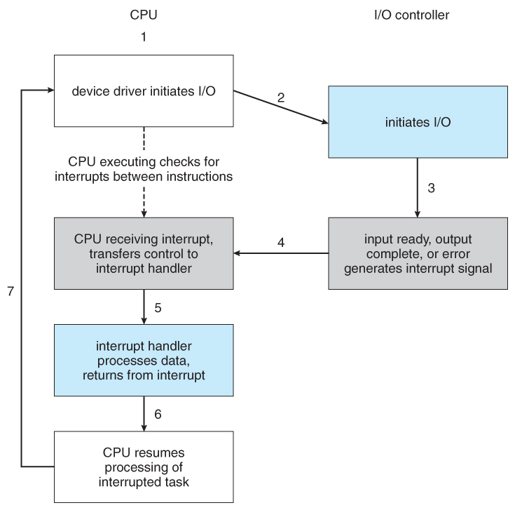
Interrupt handling

Slide 38
Device Drivers
A device driver is a program that controls a particular type of device that is attached to user computer. There are device drivers for printers, displays, CD-ROM readers, hard disk and so on
A driver provides a software interface to hardware devices, enabling operating systems and other computer programs to access hardware functions without needing to know precise details of the hardware being used.

Slide 39
Device driver
Writing a device driver requires an in-depth understanding of how the hardware and the software works for a given platform function. Because drivers require low-level access to hardware functions in order to operate, drivers typically operate in a highly privileged environment
A driver is software that allows your computer to communicate with hardware or devices.
Without drivers, the hardware you connect to your computer—for example, a video card or a printer—won't work properly.

Slide 40
Device driver
A driver typically communicates with the device through the computer bus or communications subsystem to which the hardware connects.
Drivers are hardware-dependent and operating-system-specific.

Slide 41
Purpose of device drivers
Device drivers simplify programming by acting as translator between a hardware device and the applications or operating systems that use it.
Programmers can write the higher-level application code independently of whatever specific hardware the end-user is using.
For example, a high-level application for interacting with a serial port may simply have two functions for "send data" and "receive data". At a lower level, a device driver implementing these functions would communicate to the particular serial port controller installed on a user's computer.

Slide 42
Device driver has two parts
Device specific: This portion of a device remains the same across all operating system and is more about understanding and decoding the device data than software programming. A data sheet for a device is a document with technical details of the device, including its operation, performance, programming etc
OS specific: this portion is tightly coupled with the OS mechanisms of user interfaces thus differentiates a linux device driver from windows device driver

Slide 43
General classification of device driver
Serial port drivers
Network device drivers
Flash
Bus driver

Slide 44
Device independent I/O software
The device independent code contains most of the I/O functionality, but not most of the code since there are many drivers
All drivers do the same thing in slightly different ways due to slightly different controllers
Functions of device independent I/O software
It provides buffering
Support for error reporting
Provides uniform interfacing for device drivers
Perform allocation and releasing dedicated devices
Software provides a device independent block size

Slide 45
buffering
“Buffering” is a technique by which the device manager can keep slower I/O devices busy during times when a process is not requiring I/O operations
Input buffering: is a technique of having the input device read information into the primary memory before the process requests it
Output buffering: is the technique of saving information in memory and then writing to the device while the process continues execution

Slide 46
Types of I/O buffering schemes
Single buffering
Double buffering
Circular buffering
No buffering

Slide 47
File Management

Slide 48
Basic File Concept
Users data is stored in the computer Memory in terms of File.
Permanent storage of information and data is a File
A file is a named collection of related information.
File provides an easy means of information sharing
The operating system is not interested in the information stored in the files, operating system maps files with physical devices
A program which user prepare is a file. File represents program and data
File contains various types of data like source program, object program, text and numeric data, images, graphs, sounds, payroll records etc.

Slide 49
File naming
File store information on the disk
Once a file is created it is named for identification.
File name continues to exist even after closing a file
Different operating systems have various notation for naming a file.
File name contains two parts, it is separated by a period ( . ). For example: sorting.c
In the file name, after period ( . ) is called file extension that indicates something about the file
The system uses the extension to indicate the type of the file and the type of operations that can be done on that file

Slide 50
File types – Name, extension

Slide 51
Types of file (According to internal structure of a file)
File types represents the internal structure of the file. According to the structure, file is divided into certain types
Text file: It is the sequence of characters which are organized into lines. Text file is a regular file
Source file: It contains sequence of subroutines, procedures and functions
Executable file: It contains a series of code sections. This file is input to the loader and loader loads the file into memory then execute
Object file: An object file is a binary file that the compiler creates by converting the source to object code
When operating system defines different file structures, it also contains the code to support these file structure. Unix, MS-DOS support minimum number of file structure.

Slide 52
File types
File is divided into following types
Ordinary file
Directory file
Device/ Special file
Character device file
Block device file

Slide 53
Ordinary file
Ordinary file is also called regular file
It contains only data as a stream of characters
An ordinary file cannot contain another file or directory
It is either a text file or a binary file
Examples of ordinary files include simple text files, application data files, files containing high level source code, executable text files and binary image file
Text file: it contains only printable characters
Binary file: it contains the printable and unprintable characters that covers the entire ASCII range
Regular files may be created, browsed through and modified by various means such as text editors

Slide 54
Directory file
A directory file is like a folder that contains other files, including subdirectory files
Directory files act as a container for the other files, of any category.
Directory files don’t contain data,they merely contain references to the files contained within them
Directory is created in UNIX by the mkdir command
Directory is removed by using rmdir command.
Content of directory is displayed by ls command

Slide 55
Device file
Special files are also known as device files
In UNIX, all physical devices are accessed via device files; they are what programs use to communicate with hardware
These files hold information on location, type and access mode for a specific device
There are two types of device files
Block device file: these files are used to access block device I/O
Character device file: These files are associated with character or raw device access
Device files are created using mknod command

Slide 56
File attributes
Name – only information kept in human-readable form.
Identifier: Every file is identified by a unique tag number within a file system
Type – needed for systems that support different types.
Location – pointer to file location on device.
Size – current file size.
Protection – his attribute assigns and controls the access rights of reading, writing, and executing the file.
Time, date, and user identification – data for protection, security, and usage monitoring.
Information about files are kept in the directory structure, which is maintained on the disk.

Slide 57
File operations
create
write
Read
reposition within file – file seek
delete
open
Close
Truncate
Rename
Append

Slide 58
File structure
File structure provides the mechanism for an on-line storage of and access to both data and program of the OS and all the users of the computer system
The general file structure are as follows
Unstructured sequence of bytes
Sequence of fixed-length records with internal structure
Tree of records used with mainframe systems

Slide 59
File Structure
Unstructured sequence of bytes
Most flexible
Any meaning can be imposed by the user program
Used by Unix and windows
Sequence of fixed-length records with internal structure
One entire record is read/written at a time
This structure is not used currently
Tree of records used with mainframe systems
Records may be of varying lengths
Each record has a key in fixed position in a record
Records sorted by the key for easy search

Slide 60
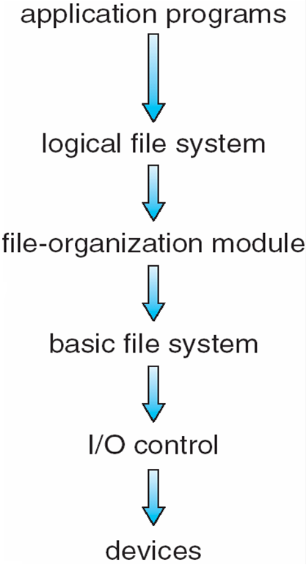
Layered File System

Slide 61
File access methods
File access method defines the way process read and write files. Access method means accesses to files that use a particular file organization are implemented by an input output control system
Sequential access
Index sequential method
Direct/Random access

Slide 62
Access Methods
Sequential Access
read next
write next
reset
no read after last write
(rewrite)
Direct Access
read n
write n
position to n
read next
write next
rewrite n
n = relative block number

Slide 63
Sequential access method
Sequential access method is simple method. The information in a file is accessed sequentially one record after another
In this method, a process could read all the records in a file in order, starting at the beginning
A read operation reads the next portion of the file and automatically advances a file pointer
A write appends to the end of the file and advances to the end of the newly written material
Sequential access is based on a tape model of a file and works as well on sequential-access devices
Compiler and editor usually access files in this method. Transaction file is also example of sequential access method

Slide 64
Disadvantages of sequential access method
It provides poor performances
More efficient search technique is required

Slide 65
Index sequential method
These methods construct an index for the file
The index, like an index in the back of a book, contains the pointer to the various blocks
To find a record in the file, we first search the index and then by the help of pointer we access the file directly.
To find an entry in the file , we first search the index and then use the pointer to access the file directly and to find the desired entry
Disadvantages of Index Sequential File:
The index file itself, may become too large to be kept in memory
The primary index file would contain pointers to secondary index files

Slide 66
Direct access method
It is also called random access method
This access allows a user to position the read/write mark before reading and writing
The file is viewed as a numbered sequence of block or record
Direct access method provides, accessing the records directly. Direct access method is based on the hard disk that is a direct access device it allows random access of any block
Each record has its own address on the file with by the help of which it can be directly accessed for reading or writing
There is no restriction on the order of reading and writing for a direct access file

Slide 67
At the time of file creation, access method is defined. According to defined access method, file is accessed
Sequential access of direct file is possible but direct access of sequential file is not
A block number provided by the user to the operating system is normally a relative block number.
The first relative block of the file is 0 and then 1 and so on
Disadvantages of Direct access method
Poor utilization of input output devices
Consumes CPU time for record address calculation

Slide 68
Directory
Directory is a data structure that lists files and subdirectories in a collection. Directory structure contains a list of entries one for each file
Directory does not store any user data but contains only its reference
File system maintain directories or folders for keeping information of files.
User stores file in a file system using directory
Directory structure organizes and provides information about the files in a system

Slide 69
Directory
single dot (.) indicates a current directory and double dot (..) indicates a parent directory. The root is identified by the directory ‘/’. The root file system has several subdirectories
Window file system uses a letter followed by colon for specifying root directory. For ex. Root directory in window is C:, D: or E:
Unix and Linux file system uses slash (/) for specifying root directory

Slide 70
Operation on directory
File searching: directory structure is searched for particular file entry. File uses symbolic names and similar names may indicate a relationship between files
Create a file: user create new file and added to the directory
Delete a file: user delete the file after completing its work on files
Rename a file: user change the file name if file content is change
Listing of directory: listing of file in the directory for some use. MS-DOS and Windows uses “dir” command and Linux/Unix uses “ls” command for this purpose

Slide 71
Directory Structure
A collection of nodes containing information about all files.
Directory
Files
F 1
F 2
F 3
F 4
F n
Both the directory structure and the files reside on disk

Slide 72
Directory structure
There are various structure of directory
Single level directory
Two level directory
Tree structured directory
Acyclic graph directory
General graph directory

Slide 73
Single level directory
This is simple directory structure and easy to understand.
In single level directory all files of all users are store in one directory.
Directory
File -1
File- 2
File- 3
File -4

Slide 74
Single level directory
Here the directory has 4 files (in fig).
One limitation in single level directory is file naming. All the file name must be unique into the directory.
If Duplicate name of the file is given by user, than unique name rule will be violated.
MS-DOS O.S. allow 11- character and UNIX /LINUX allow 255 character for file name.

Slide 75
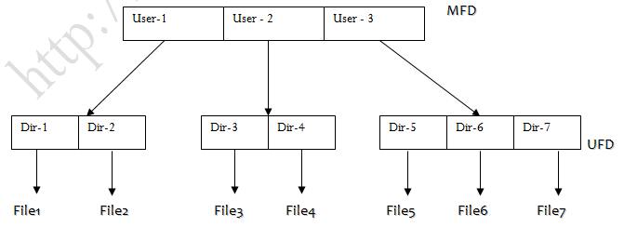
Two level directory
The unique name problem is removing into the two level directories.
To remove this problem each user has its own directory.

Slide 76
Two level directory
In two level each user has its own directory called user file directory (UFD).
Every UFD contain the files of only one user.
When user will login, system will search Master file directory (MFD) by name or account number of user .
MFD contain entry for users by name or account number and each entry point to the UFD for that user.
Here in users UFD, filename must be unique.

Slide 77
Two level directory
To create or delete the file, system searches only those users UFD.
Here every user can work independently but can’t not use or share files of whether user.
Path into two level directories is from MFD to the file.
In fig. path of file-1 will be: user 1/dir-1/ file1.
This structure mainly used in multi user systems.
This structure is not suitable when user has large number of files.

Slide 78
Tree structure directory
Tree structure is generalization of two level directory structure.
In tree structure user can create is own directories, subdirectories and files.
Tree has a root directory.
Every file in a system has unique path from root to the specific file.
Here directory contain sub-directories and set of files.

Slide 79
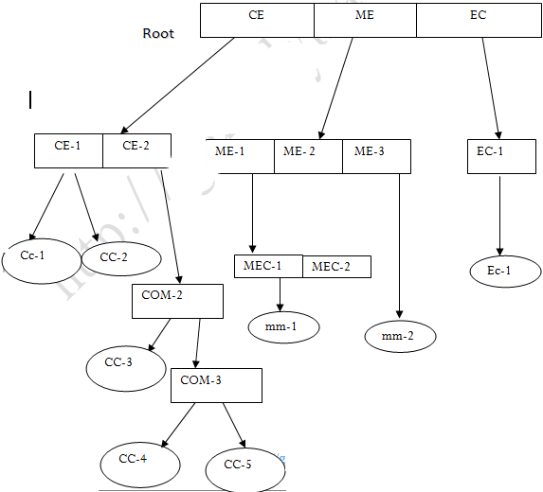
Tree directory structure

Slide 80
Tree structured directory
In which directory user currently working is called current directory .
There are two type of path :
Absolute path :- path from root directory to specific file called absolute path.
e.g. : Absolute path of file cc-5 will be :
root / CE / CE-2/ COM-2 / COM-3 / CC-5
Relative path :- Path from current working directory to specific file called relative path.
e.g. : if user currently working into directory CE-2 then relative path of file cc-5 will be :
CE-2 / COM-2 / COM-3 / CC-5

Slide 81
Problem of deletion into tree structure
User can not delete directly any directory or sub-directories.
To delete directory user must has to remove all files from directory.
If directory is not empty and contains some file or sub-directories then directory will not be removed.
In tree structure, user can not share files or directories.

Slide 82
Acyclic graph structure
Acyclic graph is slightly different from tree structure.
Acyclic graph structure allow user to share files and sub directories.
In acyclic graph same file or sub-directories may be link in two different directories.

Slide 83
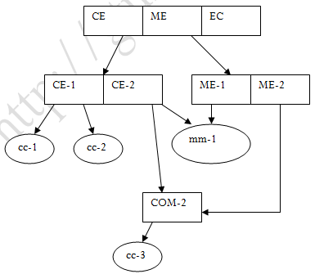
Acyclic graph structure

Slide 84
Acyclic graph structure
In fig. CE-2 and ME-1 directories has same file mm-1 and CE-2 and ME-2 directories has same sub-directory COM-2.
Disadvantages :-
Here several absolute path for files.
Another problem of deletion because when space allocated to shared to be de-allocated.

Slide 85
General graph directory
In Acyclic graph there is no cycles.
When link is add to the existing tree structure directory then it is called general graph directory.

Slide 86
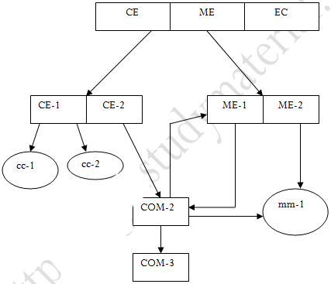
General graph structure

Slide 87
General graph directory
Here directory is link with its subdirectory and subdirectory is link with its directory.
In fig. COM-2 is subdirectory of ME-1,ME-1 is link with COM-2 and COM-2 is link with ME-1,HERE cycle is created between ME-1 and COM-2.

Slide 88
File sharing and protection
File owner/creator should be able to control:
what can be done
by whom
Types of access
Read
Write
Execute

Slide 89
File protection
All data and information in computer system are stored in the form of files. So protection of file required from physical damage of system or improper access of file.
Access is permitted or denied depending on several factors
Reliability or Physical Damage
Reliability of file provide by duplicate copies of file.
Many system provide facility of automatic backup of files.
File system can be damage by Hardware Problems or Power failure.

Slide 90
Protection of improper Access
There are various methods used for protection of file among improper access of file.
Types of Access:
Some system permits access of file to all users, so protection is not required.
But Some system provide free access to users, in these type of system protection is provided by control Access.
In control Access method, types of file access is limited, some operation on file will be controlled.
Access Method defines which users have what privileges and permission to excel.

Slide 91
There are several operation may be controlled.
Read: Read from the file.
Write: Write to file.
Execute: Execute the file.
Any other operation like Rename, Repositioning, and Truncate may be controlled.

Slide 92
Access list & Groups:
Access list
“Access list” method provide identity dependent file access associated with each file and directory.
Access list specify the username and type of access allowed to each user, when user request access to particular file, operating system check the access list associated with file, if user listed for requested access, than access is allowed, otherwise user can not access.
By using the command ls –l,we can see the long listing details about the file.

Slide 93
groups
Many system classify the users in 3 group:
Owner: The user who created the file.
Group: A Group of user who sharing the file.
Universe/Others: All other users in the system.
In this type of protection, only 3 operation are required, Read-r ,Write-w, And Execute-x .
Value assigned for these protection modes
Read(r) = 4, Write(w)= 2, Execute(x)=1

Slide 94
File sharing and protection
Mode of access: read, write, execute
Three classes of users
RWX
a) owner access 7 ⇒ 1 1 1 RWX
b) groups access 6 ⇒ 1 1 0
RWX
c) public access 1 ⇒ 0 0 1
Ask manager to create a group (unique name), say G, and add some users to the group.
For a particular file (say game) or subdirectory, define an appropriate access.

Slide 95
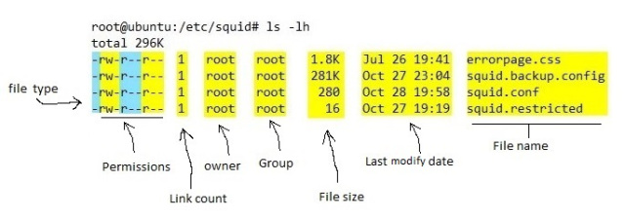

Slide 96
File sharing and protection
owner
group
public
chmod
761
game
Attach a group to a file
chgrp G game

Slide 97
File allocation methods
Many files are stored on the same storage device.
Allocation of file means allocate the space for store the file on the disk.
Files are stored in free blocks of disk. each block size is 512 bytes.
There are three methods are used to allocate the space for file on disk.
There are various allocation method
Contiguous allocation method
Linked allocation method
Indexed allocation method

Slide 98
Contiguous allocation method
In this method, contiguously blocks are allocated to the file on disk.
The first block is generated randomly so the block can be anywhere in memory
Contiguous Allocation of file define by block address and length( total number of block)
Suppose a bspp file, need 3 blocks on disk. In figure file bspp is allocated at block number 5 ,6 and 7, so its starting block will be 5, and length is 3, because 3 blocks are allocated .
Entry in directory for file bspp will be :
File Start length
bspp 5 3

Slide 99
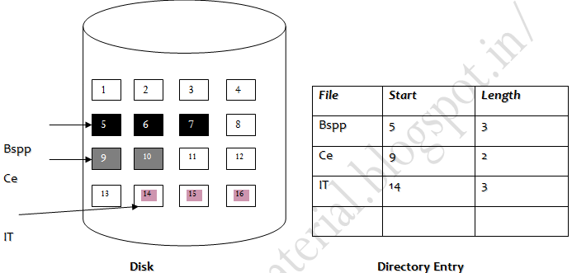
Contiguous allocation method

Slide 100
Contiguous allocation method
If file size is 4 block , then continuously 4 blocks will be allocate to file on the disk.
Each block of disk will store 512 bytes .
Next file is Ce ,this file need 2 blocks, here continuously block 9 and 10 are allocated to it.
One disadvantage of contiguous allocation method is finding space for new files.
In contagious Allocation directory contain filename, start block and length.
The FAT table contains the name of the file,Starting location or block of file and third contains the total length of the file.
Contagious allocation support both sequential and direct access method

Slide 101
As the blocks are not in continuous order it suffers from the disadvantage of Fragmentation.
To overcome the disadvantages of Fragmentation, Compaction technique is used.
In Compaction all the allocated blocks are grouped at the top and all the free blocks are allocated later.
So we get continuous block of memory after Compaction.

Slide 102
Contiguous allocation method
Advantages
Simple to implement
Fast access of file
Disadvantage
Finding the free space on disk.

Slide 103
Linked allocation method
Linked allocation is different from contagious allocation.
In Linked allocation, blocks of file are linked with other blocks.
Here blocks are allocated randomly and blocks are linked one by one.
Each block will link with the next block of file.
Here the directory contains file name, start blocks number and ending block number.
In this method OS will allocate the free block randomly and link every block with next block of file.

Slide 104
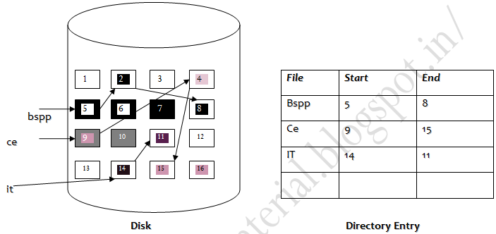
Linked allocation method

Slide 105
Linked allocation
Example :- in fig. for file bspp, start block number is 5, and ending block number is 8.
Block 5 will link with next block 2, and block is link with block 8. Total 3 blocks are allocated to bspp file.
Block 5 is starting block number which will point to next block 2, block 5, contain the address of block 2, block 2 point to block 8.
Here all blocks are linked.
Same procedure is for file ce and IT.
Linked allocation can support only sequential access. It is not support direct access.
Linked allocation is also called chain allocation.

Slide 106
Linked allocation
Advantages
Any free block can be allocated
Disadvantages
In linked allocation is each block contain the pointer to next block of file, 4 byte is used to store the pointer of block of 512 bytes.
It users a pointer so if a pointer field consist of error it gives error that a whole file is corrupted as maintenance of pointer is difficult
The major problem is that it can be used only for sequential access-files.
So only 508 byte of data can be stored.

Slide 107
Indexed allocation
In index allocation all pointer for blocks are bringing together into only one block of disk. In index allocation all pointers are put into one block. This block is called index block.
Each file has its own index block, which contain the pointer address of all blocks of files which are allocated on disk.
In index allocation directory entry contain the filename and index block.

Slide 108
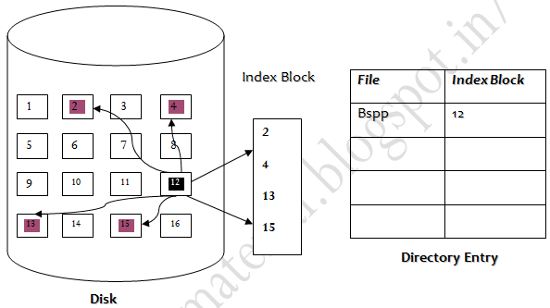
Indexed allocation

Slide 109
Indexed allocation
For example : In fig file bspp, has index block 12, means blocks 12 will contain the pointer of all blocks of file.
here block 12 is containing address of block 2,4,13 and 15.
Every file has only one index block. and it should be unique.
Index allocation supports direct access.
No more than one file has same index block.
Disadvantage: - In index allocation there are lot of waste of space into the index block. Because index block of 512 byte contain only address of pointer, so maximum space is waste into the index block.

Slide 110
Memory management / Free space management using Bitmap and Linked list
Files are created and deleted frequently by the user of Computer system. If the files are created and its not being used for larger time it unnecessary uses an memory.
Since disk space is to be allocated to files, the free space available must be managed so as to allocate space to the new files being created
To retain the information about the free disk space, the system maintains a free-space list. The free-space list keeps information about the free disk blocks
Two methods are used for free memory management
1) Bit Map
2) Linked List

Slide 111
Memory management by Bitmap
This method represents the allocation status of disk block as a bit map or bit vector.
Each block is represented by 1 bit. If the block is free, the bit is 0; if the block is allocated, the bit is 1
For example, consider a disk with 30 blocks
The bit map can be: 000001111001111110001100000011
If the blocks 2,3,4,5,8,9,10,11,12,13,17,18,25 are free then
001111001111110001100000010000…….
The main advantages of this method is its relatively simple and n contiguous free blocks that can be found together
Each time a new block is to be allocated to a file, the bit vector will be updated respectively.

Slide 112
Memory management by Linked list
In this method of free space management, all the free blocks are linked with each other and the pointer referencing to the first free block is placed in a special location on the disk and cached in memory
This first block holds an address pointing to the next free disk block and so on
However, this method is not efficient because traversing of the list requires the reading of each block, which consumes more I/O time

Slide 113
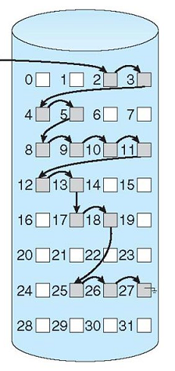
Memory management by Linked list

Slide 114
Memory management by Linked List
The free space list given in figure is as follows; a pointer is stored for block 2, as the first free block.
Block 2 would contain a pointer to block 3, which would point to block 4 and so on

Slide 115
File System implementation
There are 2 methods to implement file system depend on the types of the operating system
On-disk structure
In-memory structure

Slide 116
On-disk structure for file implementation
On disk, file system may contain information about how to boot an operating system stored there, total number of blocks, the number and location of free blocks, the directory structure and individual files. Some of these structures are described as follows:
Boot control block(per volume): It can contain information needed by the system to boot an operating system from that volume. If disk does not contain OS, this block can be empty. This is typically the first block of a volume. In UFS, it is called boot block; in NTFS it is called partition boot sector

Slide 117
On-disk structure for file implementation
Volume control block(per volume): it contains volume (or partition) details, such as number of blocks in a partition, the size of block, a free block count, a free block pointers and free FCB count and free FCB pointers. In UFS, it is called superblock; in NTFS, it is stored in master file table
A directory structure (per file system) is used to organize the files. In UFS, this include file names and associated inode number. In NTFS, it is stored in master file table
A per-file FCB(File control block) contains many details about the file. It has unique identifier number to allow association with a directory entry.

Slide 118
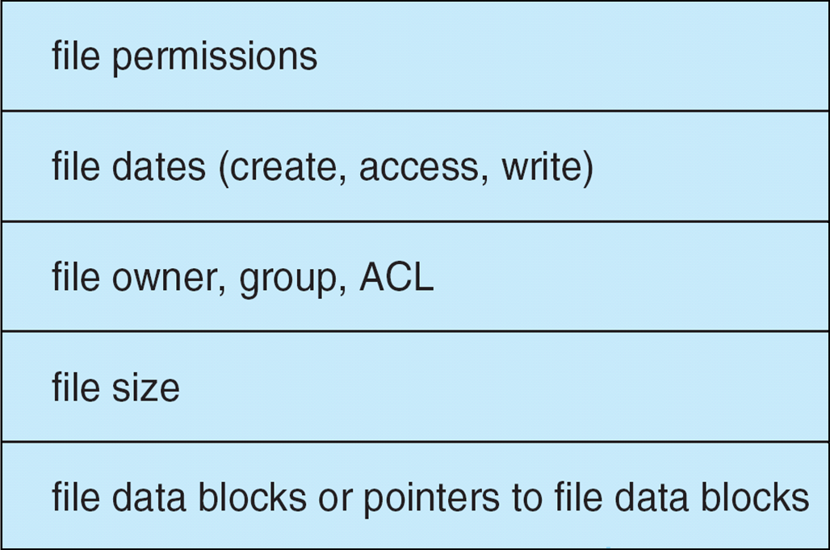
Typical FCB is shown in figure
In NTFS, this information is actually stored within master file table which uses relational database structure, with a row per file

Slide 119
In-Memory structure of file implementation
The in-memory information is used for both file system management and enhancing the performance through caching. This structure includes the following:
In-memory partition table: it contains the information about each mounted partition.
An in-memory directory structure: This directory structure cache holds the directory information of recently accessed directories
System-wide open-file table: It is used to maintain a copy of FCB of opened file along with its other information
Per-process open-file table: it has a pointer to the suitable entry in the system-wide open-file table along with other information

Slide 120
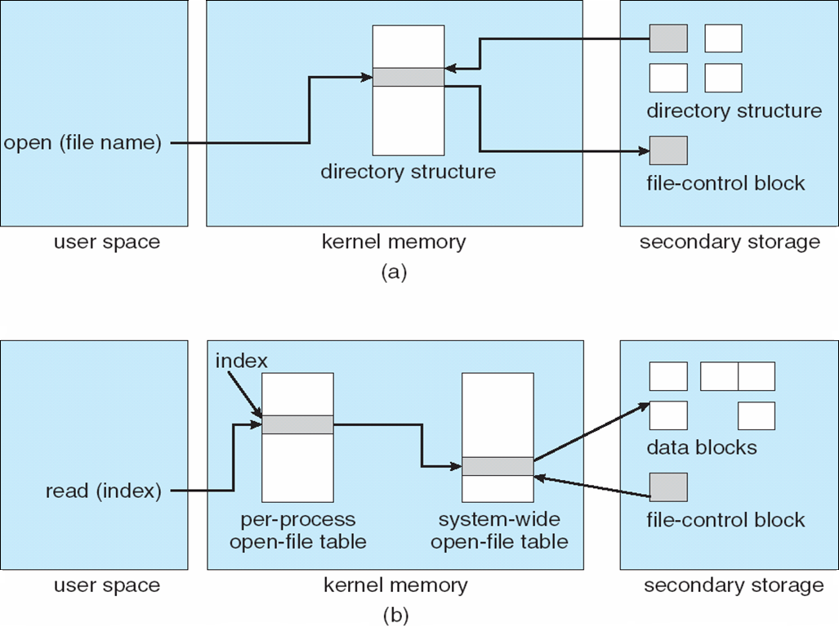
In-Memory structure of file implementation

Slide 121
Directory Implementation
The selection of directory-allocation and directory management algorithm significantly affects the efficiency, performance and reliability of the file system
The different organizations are:
Liners list
Hash table

Slide 122
Directory implementation using linear list
The simplest method of implementing a directory is to use a linear list of file names with pointers to the data blocks
This method is simple to program but time consuming to execute
To create a new file, we must first search the directory to be sure that no existing file has the same name. then ,we add the new entry at the end of directory
To delete a file, we search the directory for the named file and then release the space allocated to it.

Slide 123
Directory implementation using linear list
The real disadvantage of the linear list of directory entries is that finding a file requires a linear search
Directory information is accessed frequently, thus in many OS, a software cache is used to store the most recently used directory information
If a sorted list of file names is maintained, then a binary search can be used to decrease the average search time.
Other data structure like B-Tree might be of an advantage in this type of a case

Slide 124
Directory implementation using hash table
Hash table is the another method for implementing directory structure
With this method, a linear list stores the directory entries, but hash data structure is also used.
The hash table takes a value computed from a file name and return a pointer to the file name in the linear list
It can greatly decrease the directory search time.
Insertion and deletion are also fairly straight forward although some provision must be made for collision – situation in which two file names hash to same location

Slide 125
Directory implementation using hash table
To resolve this problem, chained-overflow hash table is used
Each hash entry can be linked list instead of an individual value. It means if the hash values point to the same location, a chain of linked list is formed
So, in this way we can remove the collisions

Slide 126
File system recovery
There are many causes that are responsible for computer crashes or physical damage, and in this situation, file systems are expected to behave sensibly. These problem may result in file system consistencies
In order to check consistency, we need to observe the following:
All data and control structure, such as descriptors and bitmaps should be in an appropriate arrangements
When a system reboots, it should return to a valid state
It at the time of crash, a write operation is in progress, then the operation is either finished or rollback completely. This is called atomicity

Slide 127
File system recovery
Consistency checker: at the time of reboot, a program called consistency checker, is executed in order to check and correct disk inconsistencies
The consistency checker matches the data available in the directory structure with the data stored in blocks of disk and if it finds any inconsistencies, then it tries to fix it
Methods of file system recovery
Backup and restore
Log-structured file system

Slide 128
Backup and recovery
When the magnetic disks fails, a backup of disk may be taken on another storage device in order to restore the system
For minimizing the copy, the time when the last file was modified and the backup taken can be considered
The file’s last write date in the directory structure specifies that the file has not changed since that date, and then it is not required to copy that file again.

Slide 129
Log structured file system
The main purpose of using the log structured file system is to enhance the write performance
It buffers a series of file system changes in the file cache and them write all such changes to the disk sequentially in a single write operation
Once the changes are written to the log, user process are allowed to continue execution
It transaction is completed, it removes the log files
If the system crashes, there will be zero or more transactions in a log file. Therefore they must be completed, and the file system structure remain consistent.

Slide 130
Virtual file system
A virtual file system (VFS) is programming that forms an interface between an operating system's kernel and a more concrete file system.
The purpose of a VFS is to allow client applications to access different types of concrete file systems in a uniform way
A VFS can, for example, be used to access local and network storage devices transparently without the client application noticing the difference
“It can be used to bridge the differences in Windows, Mac OS and Unix filesystems, so that applications can access files on local file systems of those types without having to know what type of file system they are accessing.”

Slide 131
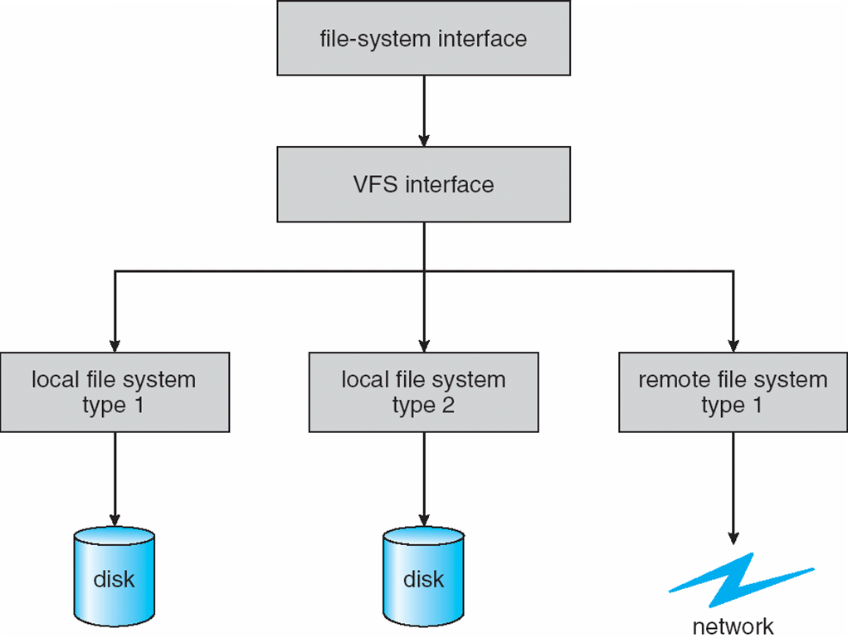
Virtual file system

Slide 132
File system performance
File System performance is often a major component of overall system performance, and is heavily dependent on the nature of the application generating the load.
To achieve optimal performance, the underlying file system configuration must be balanced to match the application characteristics.
Once we have a good understanding of the application, we can try and optimize the file system configuration to make the most efficient use of the underlying storage device.

Slide 133
Our objective to improve file system performance is to:
Reduce the number of I/O's to the underlying device(s) where possible
Group smaller I/O's together into larger I/O's where possible
Optimize the seek pattern to reduce the amount of time spent waiting for disk seeks
Cache as much as data as realistic to reduce physical I/O's

Slide 134
Refrences
[1]. Operating System Concepts - 9th Edition by Abraham Silberschatz, Peter Galvin, Greg Gagne, Wiley Asia Student Edition.
[2]. Operating Systems: Internals and Design Principles - 5th Edition, William Stallings, Prentice Hall of India
[3]. Modern Operating Systems- 4th Edition Andrew S. Tanenbaum, Pearson Education India
[4]. Operating Systems: A Modern Perspective - 2nd Edition by Gary J. Nutt, Addison-Wesley
[5]. File System Concepts

Slide 135


